Slide 1
Big Data Analytic project
Google Play Store Apps Analysis
411021206 莊芳儒、411021209 張佩慈、411021231 林芷安

Slide 2
Table of contents
01
Introduction
02
Analysis
Introduce the Dataset
Data Preprocessing and Chart Analyzing
03
Forecasting
04
Demonstration
Correlation Analysis and Downloads Prediction
Run the Code

Slide 3
Introduction
01
Introduce the dataset

Slide 4

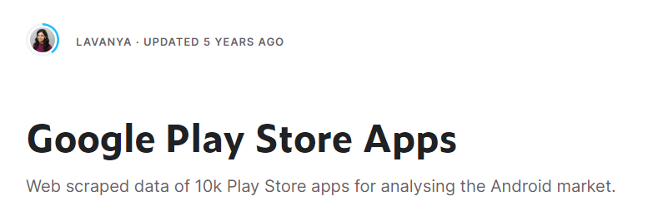
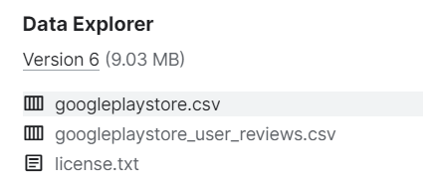
Data selection

Slide 5
Data feature
Googleplaystore.csv
App | The name of the app. | Price | The price of the app.
Category | The category of the app. | Content Rating | The appropriate target audience of the app.
Rating | The rating of the app. | Genres | The genre of the app.
Reviews | The number of reviews of the app. | Last Updated | The date when the app was last updated.
Size | The size of the app. | Current Ver | The current version of the app.
Install | The number of installs of the app. | Android Ver | The minimum Android version required to run the app.
Type | Free or Paid.

Slide 6
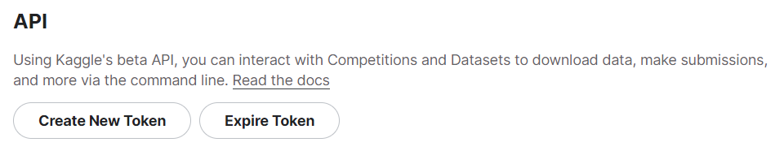
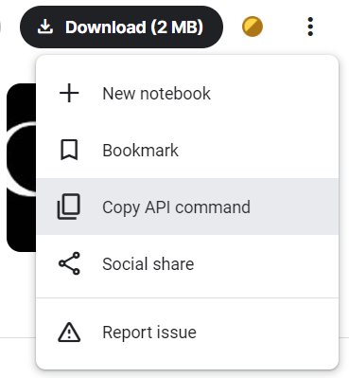

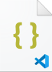
Download
PS E:\code\python> pip install kaggle
.kaggle
kaggle

Slide 7
Download
1 os.system('kaggle datasets download -d lava18/google-play-store-apps') # kaggle API
2 os.system('mkdir unzip') # create directory
3 4 def extract_files(zip_path, output_dir): # unzip the file
5 with zipfile.ZipFile(zip_path, 'r') as zipf:
6 zipf.extractall(output_dir)
7
8 extract_files('google-play-store-apps.zip', 'unzip’)
9 path = "C:/Users/asus/.spyder-py3/project/unzip/googleplaystore.csv"

Slide 8
Analysis
02
data preprocessing and chart analyzing.

Slide 9
Python Package Index
1 import numpy as np
2 import pandas as pd
3 import seaborn as sn
4 import matplotlib.pyplot as plt
5 from sklearn.cluster import KMeans
6 from sklearn import linear_model
7 import zipfile
8 import os

Slide 10


Data Preprocessing
Cleaning
Remove the missing value
1 data.drop(index = 10472, inplace = True)
2 a = data.dropna()
Feature ‘Installs’
Remove ‘+’ and ‘,’ then convert string to number
1 a.Installs = a.Installs.apply(lambda x: x.replace('+', ""))
2 a.Installs = a.Installs.apply(lambda x: x.replace(',', ""))
3 a.Installs = pd.to_numeric(a.Installs)

Slide 11

Data Preprocessing
Feature ‘Price’
Remove ‘$’ then convert string to number
1 a['Price'] = a['Price'].apply(lambda x: x.replace('$', ""))
2 a['Price'] = pd.to_numeric(a['Price'])
Feature ‘Reviews’
Convert string to number
1 a['Reviews'] = pd.to_numeric(a['Reviews'])

Slide 12

Data Preprocessing
Feature ‘Size’
Change the unit to MB
1 def convert(size):
2 if type(size) == str:
3 if 'k' in size:
4 return format(float(str(size).replace('k', "")) / 1024, '.3f')
5 if 'M' in size:
6 return float(str(size).replace('M', ""))
7 else:
8 return(size)
9 a['Size'] = a['Size'].str.replace('Varies with device', '0.00')
10 a['Size'] = a['Size'].apply(lambda x: convert(x))
11 a['Size'] = pd.to_numeric(a['Size’])
12 a['Size'].fillna(format(a['Size'].mean(), '.3f'), inplace = True )
13 a['Size'] = pd.to_numeric(a['Size'])

Slide 13
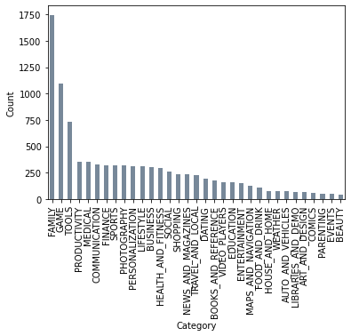
Chart Analysis
Category-Count bar
Display the number of apps in each category
1 value_count = a['Category'].value_counts()
2 value_count.plot(kind = 'bar’,
3 color = 'lightslategray’)
4 plt.ylabel('Count’)
5 plt.show()

Slide 14
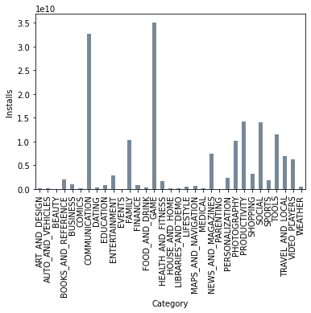
Chart Analysis
Category-Install bar
Display the downloads in each category
1 S = a.groupby('Category')['Installs'].sum()
2 S.plot.bar(color = 'lightslategray’)
3 plt.ylabel('Installs’)
4 plt.show()

Slide 15
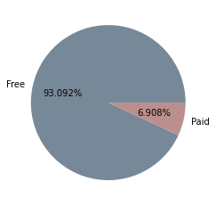
Chart Analysis
Free vs Paid app pie
Display the number of apps in free/paid.
1 C_Freecnt = C_Freec.sum()
2 C_Paidcnt = C_Paidc.sum()
3 x = [C_Freecnt, C_Paidcnt]
4 name = ["Free", "Paid"]
5 color = ['lightslategray', 'rosybrown’]
6 plt.pie(x, autopct = ‘%.3f%%’, colors = color,
7 labels = name)
8 plt.show()

Slide 16
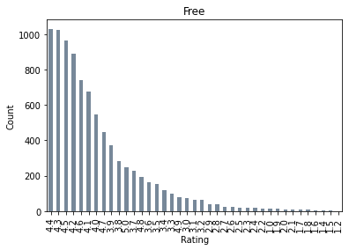
Chart Analysis
Count-Rating in Free app
Display the number of rating in free app.
1 C_Free = a.groupby('Type').get_group('Free’)
2 C_Freec = C_Free['Rating'].value_counts()
3 C_Freec.plot.bar(color = 'lightslategray’)
4 plt.ylabel('Count’)
5 plt.title('Free’)
6 plt.show()

Slide 17
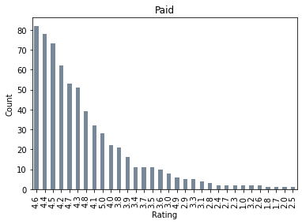
Chart Analysis
Count-Rating in Paid app
Display the number of rating in paid app.
1 C_Paid = a.groupby('Type').get_group('Paid’)
2 C_Paidc = C_Paid['Rating'].value_counts()
3 C_Paidc.plot.bar(color = 'lightslategray’)
4 plt.ylabel('Count’)
5 plt.title('Free’)
6 plt.show()

Slide 18
Chart Analysis
Count-Rating: Free vs Paid app
4.7
4.6
4.5
4.4
4.3
4.2
4.1
4.0
3.9
3.8
5.0
4.8
4.7
4.6
4.5
4.4
4.3
4.2
4.1
4.0

Slide 19
Forecasting
03
Correlation analysis and downloads prediction.

Slide 20
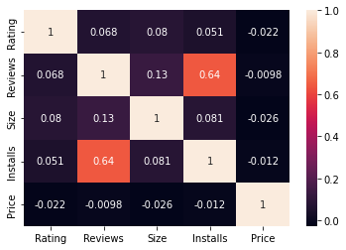
Correlation analysis
Filtering feature
We select features with correlation coefficients greater than 0.05.
1 b = pd.DataFrame(a.iloc[:,[1, 2, 3, 4, 6]])
2 corr_matrix = b.corr()
3 sn.heatmap(corr_matrix, annot = True)
4 plt.show()

Slide 21
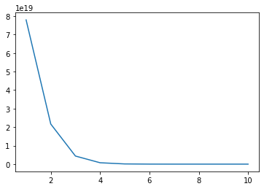
Cluster
Rating-Installs
Determine the number of clusters.
1 X = a.iloc[: ,[1, 4]]
2 wcss = []
3 for i in range(1, 11):
4 kmeans = KMeans(n_clusters = i,
5 n_init = 'auto', random_state = 0)
6 kmeans.fit(X)
7 wcss.append(kmeans.inertia_)
8 plt.plot(range(1, 11), wcss)
9 plt.show()
The gap from 2 to 3 is the largest.
3

Slide 22
Cluster
1 kmeans = KMeans(n_clusters = 3, init = 'k-means++', random_state = 0)
2 y_kmeans = kmeans.fit_predict(X)
3 X = np.array(X)
4 plt.scatter(X[y_kmeans == 0, 0], X[y_kmeans == 0, 1], s = 10, c = 'red', label = 'low')
5 plt.scatter(X[y_kmeans == 1, 0], X[y_kmeans == 1, 1], s = 10, c = 'blue', label = 'mid')
6 plt.scatter(X[y_kmeans == 2, 0], X[y_kmeans == 2, 1], s = 10, c = 'green', label = 'high')
7 plt.scatter(kmeans.cluster_centers_[:, 0], kmeans.cluster_centers_[:, 1],
8 s = 100, c = 'black', label = 'Centroids')
9 plt.title('google play store apps')
10 plt.xlabel('Rating')
11 plt.ylabel('Installs')
12 plt.legend()
13 plt.show()

Slide 23
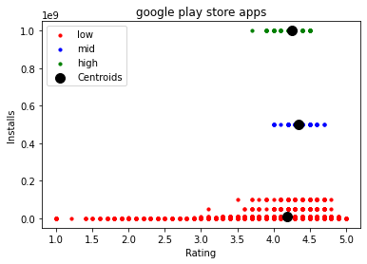
Cluster

Slide 24
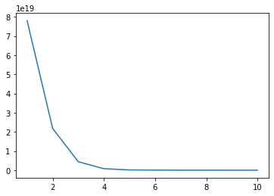
Cluster
Reviews-Installs
Determine the number of clusters.
1 X = a.iloc[: ,[2, 4]] 2 wcss = []
3 for i in range(1, 11):
4 kmeans = KMeans(n_clusters = i,
5 n_init = 'auto', random_state = 0)
6 kmeans.fit(X)
7 wcss.append(kmeans.inertia_)
8 plt.plot(range(1, 11), wcss)
9 plt.show()
The gap from 2 to 3 is the largest.
3

Slide 25
Cluster
1 kmeans = KMeans(n_clusters = 3, init = 'k-means++', random_state = 0)
2 y_kmeans = kmeans.fit_predict(X)
3 X = np.array(X)
4 plt.scatter(X[y_kmeans == 0, 0], X[y_kmeans == 0, 1], s = 10, c = 'red', label = 'low')
5 plt.scatter(X[y_kmeans == 1, 0], X[y_kmeans == 1, 1], s = 10, c = 'blue', label = 'mid')
6 plt.scatter(X[y_kmeans == 2, 0], X[y_kmeans == 2, 1], s = 10, c = 'green', label = 'high')
7 plt.scatter(kmeans.cluster_centers_[:, 0], kmeans.cluster_centers_[:, 1],
8 s = 100, c = 'black', label = 'Centroids')
9 plt.title('google play store apps')
10 plt.xlabel('Reviews')
11 plt.ylabel('Installs')
12 plt.legend()
13 plt.show()

Slide 26
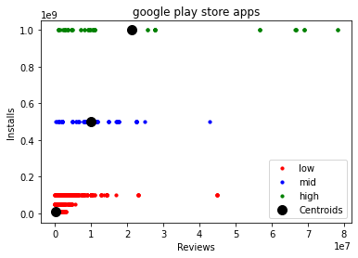
Cluster

Slide 27
Cluster
Size-Installs
Determine the number of clusters.
1 X = a.iloc[: ,[2, 4]] 2 wcss = []
3 for i in range(1, 11):
4 kmeans = KMeans(n_clusters = i,
5 n_init = 'auto', random_state = 0)
6 kmeans.fit(X)
7 wcss.append(kmeans.inertia_)
8 plt.plot(range(1, 11), wcss)
9 plt.show()
The gap from 2 to 3 is the largest.
3

Slide 28
Cluster
1 kmeans = KMeans(n_clusters = 3, init = 'k-means++’, random_state = 0)
2 y_kmeans = kmeans.fit_predict(X)
3 X = np.array(X)
4 plt.scatter(X[y_kmeans == 0, 0], X[y_kmeans == 0, 1], s = 10, c = 'red', label = 'low')
5 plt.scatter(X[y_kmeans == 1, 0], X[y_kmeans == 1, 1], s = 10, c = 'blue', label = 'mid')
6 plt.scatter(X[y_kmeans == 2, 0], X[y_kmeans == 2, 1], s = 10, c = 'green', label = 'high')
7 plt.scatter(kmeans.cluster_centers_[:, 0], kmeans.cluster_centers_[:, 1], s = 100,
8 c = 'black', label = 'Centroids')
9 plt.title('google play store apps')
10 plt.xlabel('Size')
11 plt.ylabel('Installs')
12 plt.legend()
13 plt.show()

Slide 29
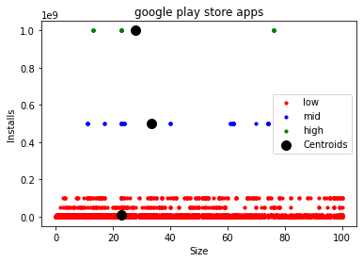
Cluster

Slide 30
Linear Regression
1 # split data into 2 parts, before and after 2018.07
2 a['Last Updated'] = pd.to_datetime(a['Last Updated'])
3 before = a[a['Last Updated'] < '2018-07-01']
4 after = a[a['Last Updated'] >= '2018-07-01']
5 6 # select feature and put into traning set and test set
7 x_train = before[['Rating', 'Reviews', 'Size']]
8 y_train = before[['Installs']]
9 x_test = after[['Rating', 'Reviews', 'Size']]
10 y_test = after[['Installs']]

Slide 31
Linear Regression
1 # train and construct model
2 regr1 = linear_model.LinearRegression()
3 regr1.fit(x_train,y_train)
4 print("f(X1, X2, X3) = " + str(regr1.coef_[0][0]) + "X1 + " + str(regr1.coef_[0][1]) + "X2 -",
5 str(-regr1.coef_[0][2]) + "X3 + " + str(regr1.intercept_[0]))

Slide 32
Linear Regression
1 # use the trained regression model to predict test dataset's target
2 y_predict = regr1.predict(x_test)
3 plt.plot(range(len(y_predict)), y_predict, 'b', label = "predict")
4 plt.plot(range(len(y_predict)), y_test, 'r', label = "test", alpha = 0.5)
5 plt.legend(loc = "upper right")
6 plt.show()

Slide 33
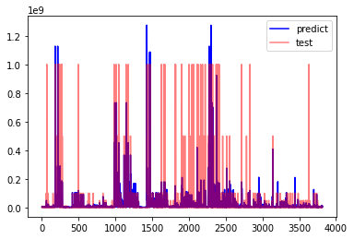
Prediction

Slide 34

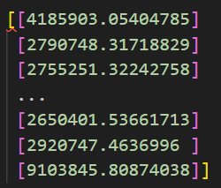
Prediction
1 print("train_accuracy : ", regr1.score(x_train, y_train)) # accuracy​
2 print("test_accuracy : ", regr1.score(x_test, y_test))​
Output :
1 b = pd.DataFrame(y_predict, columns=['Predict'])
2 b.to_csv("test.csv", index = False)
Output :

Slide 35
Demonstration
04
Run the Code

Slide 36
Thanks!

